Slide 1
Digital Portfolio
STUDENT NAME: Hemamalini.A
REGISTER NO AND NMID:24131050500122016
asanm10524131050500122016
DEPARTMENT:Bachelor Of Computer applications
COLLEGE: Periyar Arts college, cuddalore /Annamalai university

Slide 2
PROJECT TITLE
Student digital portfolio
Using back end user

Slide 3
AGENDA
Problem Statement
Project Overview
End Users
Tools and Technologies
Portfolio design and Layout
Features and Functionality
Results and Screenshots
Conclusion
Github Link
3/21/2024 Annual Review

Slide 4
PROBLEM STATEMENT
In today's digital era, traditional resumes alone are not enough to showcase skills and projects effectively. Many students and professionals lack a structured online presence to highlight their work. A digital portfolio provides an interactive and accessible platform to present achievements, skills, and experiences.

Slide 5
PROJECT OVERVIEW
are brief meanings:
1. HTML (HyperText Markup Language):
Used for structuring and organizing content on the web, like headings, paragraphs, images, links, etc.
2. CSS (Cascading Style Sheets): Used for styling and layout, controlling the visual appearance of web pages, like colors, fonts, spacing, etc.
3. JavaScript: A programming language used for adding interactivity to web pages, like animations, dynamic updates, and responding to user interactions.

Slide 6
WHO ARE THE END USERS?
Students (academic projects, resumes).
Job seekers (to share with recruiters).
Freelancers (to show clients).
Professionals (to highlight experience and achievements).

Slide 7
TOOLS AND TECHNIQUES
HTML Structure (pages, sections).
CSS Styling (colors, layouts, responsiveness).
JavaScript Interactivity (navigation menu, animations, form validation).
Mention code editor (VS Code) or CODEPEN and hosting platform (GitHub Pages)

Slide 8
POTFOLIO DESIGN AND LAYOUT
Sections included:
Home/About Me
Projects
Skills
Contact
Responsive layout (mobile + desktop view).
8

Slide 9
FEATURES AND FUNCTIONALITY
FEATURES AND FUNCTIONALITY
Navigation bar with smooth scrolling.
Project showcase with images/details.
Interactive elements (hover effects, animations).
Contact form (with validation).
Responsive design for all devices.

Slide 10
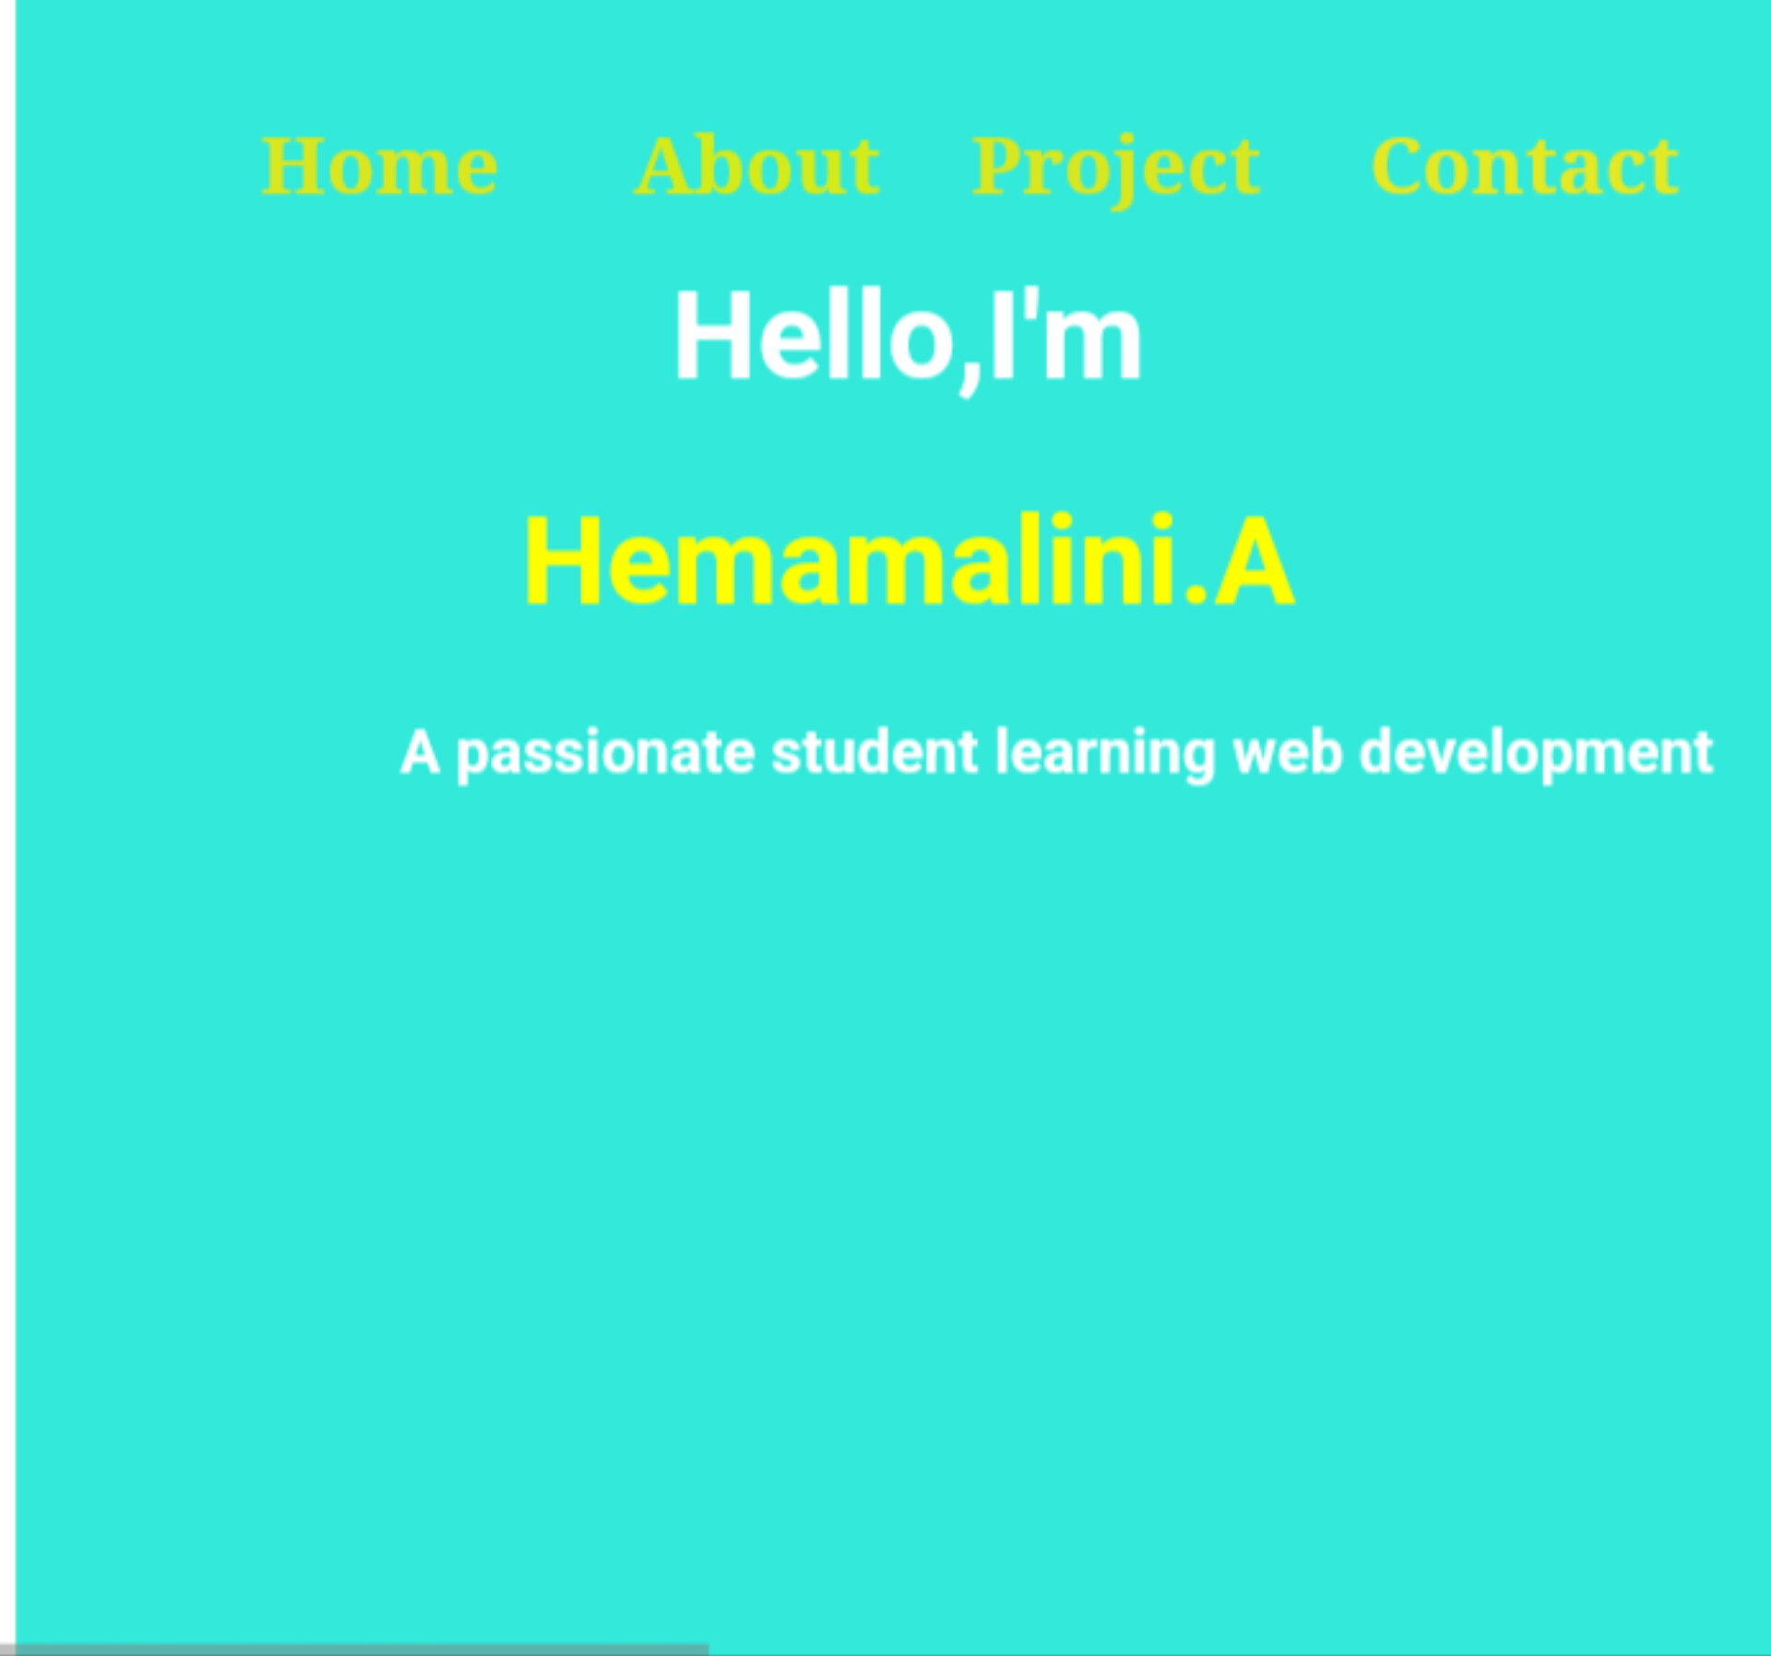
RESULTS AND SCREENSHOTS
chtml lang="en"> MyPortfolio
Home
About
//# sourceURL=pen.js
3/21/2024 Annual Review
10

Slide 11
CONCLUSION
1. Website Testing: A crucial step in
web development to ensure a website functions correctly and provides a good user experience.
2. User Experience: The primary goal of website testing is to ensure that users can navigate and interact with the website easily and efficiently.
3. Web Development: The process of building and maintaining websites, involving various technologies like HTML, CSS, and JavaScript.
1. Improved User Experience: Website
testing helps ensure that websites are user-friendly, accessible, and provide a positive experience for users.
2. Increased Accessibility: By testing
websites, developers can identify and fix issues that may prevent certain users from accessing the site, promoting digital inclusivity.
3. Enhanced Online Interactions: A
well-tested website can lead to more effective online interactions, such as e-commerce transactions, information dissemination, and communication.
4. Better Online Services: Website testing
contributes to the development of reliable and efficient online services, which can improve various aspects of life, including education, healthcare, and commerce
11

